Slide 1
CAM, Module 2
Melvin C Jose
ECE ,VJCET

Slide 2
SYLLABUS
Module 2: 8051 Architecture Microcontrollers and Embedded Processors. Architecture – Block diagram of 8051, Pin configuration, Registers, Internal Memory, Timers, Port Structures, Interrupts. Assembly Language Programming - Addressing Modes, Instruction set (Detailed study of 8051 instruction set is required).

Slide 3
8051- Features
8 bit microcontroller with 8 bit wide data bus
4 Kb of internal ROM for program storage
128 bytes of internal RAM
4 ports having a total of 32 input/output pins
Maximum addressing capacity 64k (16 bit address bus)
Two 16 bit timer/counters
Full duplex serial data receiver/transmitter
Two external and three internal interrupts

Slide 4
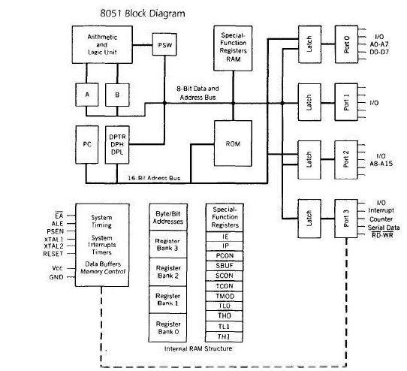

Slide 5
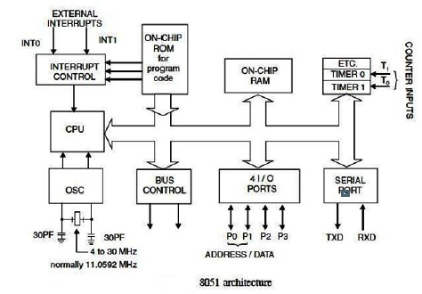

Slide 6
8051 Architecture
ALU: Performs arithmetic and logic operations like addition, subtraction, AND , OR etc.
CPU registers : A and B
A –accumulator
• 8 bit
• Used in all ALU operations
• Used for all data transfer between 8051 and external memory

Slide 7
8051 Architecture
B Register
• 8 bit
• Used for division and multiplication operations
• Also used for 8 bit data storage when not used by multiplication and division instructions
Program counter and Data pointer
• 16 bit registers
• Holds 16 bit address

Slide 8
8051 Architecture
PC
Stores the address of the next instruction to be executed
Automatically incremented after each instruction fetch
Does not have an internal address
Default value 0000h
DPTR
Made of two 8 bit registers DPH and DPL
Used for external memory access (code and data)

Slide 9
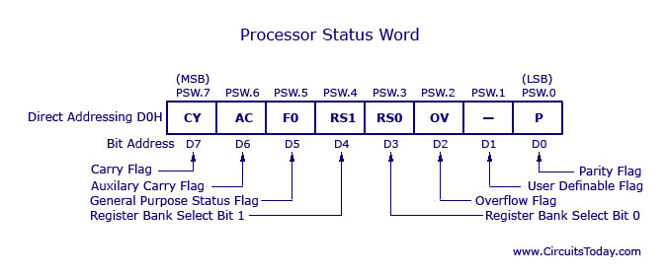
8051 Architecture
PSW

Slide 10
PSW
CY- Carry Flag: This flag is set if there is a carry out from the D7 bit. This flag is affected by addition and subtraction operations and instructions that set or clear it directly.
AC- Auxiliary Carry Flag: This flag is set if there is a carry out from the D3 to D4; otherwise it is cleared. It is used for BCD operations
F0- User Flag 0- User defined flag
RS1- Register bank select bit 1
RS0- Register bank select bit 0

Slide 11
PSW
RS1 | RS0 | Register Bank Status
0 | 0 | Select register Bank 0 (00H-07H)
0 | 1 | Select register Bank 1(08H-0FH)
1 | 0 | Select register Bank 2 (10H-17H)
1 | 1 | Select register Bank 3 (18H-1FH)
These bits are used to select the current register bank from among the 4 register banks of 8051. Their default value is 00 ie Bank0 is the default register bank.

Slide 12
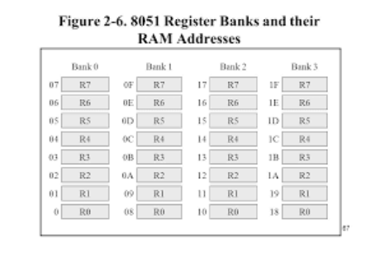
Register Banks
https://srinivas4706.blogspot.com/2019/02/unit-ii-microcontroller-notes.html

Slide 13
PSW
OV- overflow flag: This flag is set if there is an overflow into the sign bit. This occurs when the result of a signed operation is too large causing the higher order bit to overflow into the sign bit.
P- Parity Flag: If the accumulator contains odd number of 1s then P=1 else P=0
• All flags can be set or cleared by user
• Math flags-C,AC,OV and P- are also affected by ALU operations
• Of the three general purpose flags F0 is placed in the PSW and GF0 and GF1 are placed in PCON

Slide 14
STACK AND STACK POINTER
Stack is a part of internal RAM used to store and retrieve data quickly
LIFO – stack operates in last in first out manner
Stack grows up as data is stored
Stack pointer is an 8 bit register which holds the address of top of stack
Default value of SP is 07
Value of SP can be changed to any internal RAM address
PUSH and POP instructions are used to store and retrieve data

Slide 15
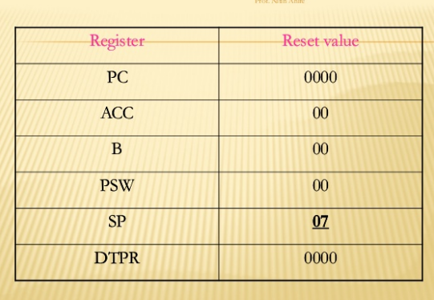

Slide 16
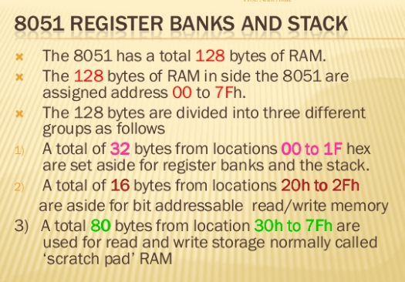

Slide 17
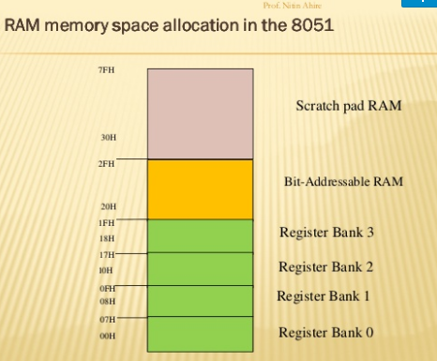

Slide 18
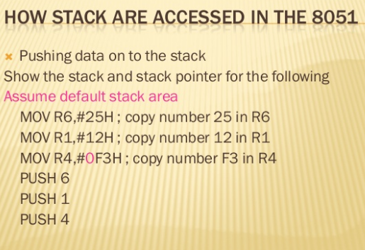

Slide 19
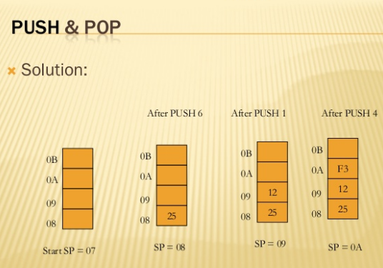

Slide 20
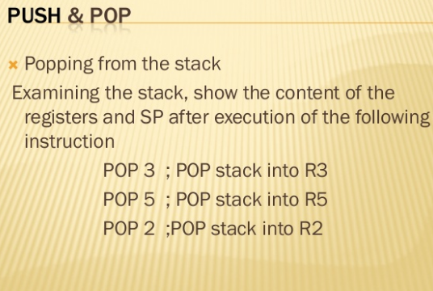

Slide 21
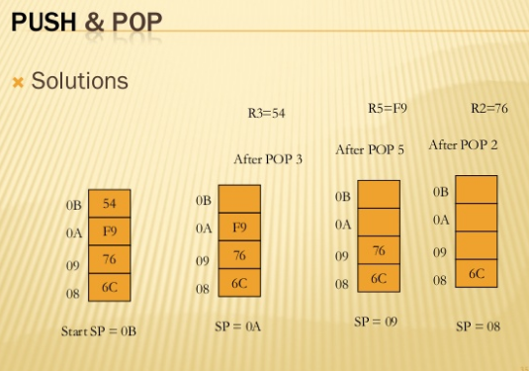

Slide 22
8051 Architecture
ROM
4 kb internal ROM for program storage
RAM
128 bytes Internal RAM
1. Register banks-32 bytes
Organized as 4 register banks
Each register bank contains 8 registers –R0 to R7
2. Bit addressable memory-16 bytes
128 bits
May be addressed by bit address or by byte address(as 8 bits)
3. General Purpose (scratch pad) RAM-80 bytes
Byte addressable

Slide 23
8051 Architecture
TIMERS
Two sixteen bit timers
May be programmed to count internal clock pulses- timer or external clock pulses- counter
I/O PORTS
32 i/o pins arranged as four 8-bit ports
SERIAL I/O
Full duplex serial data receiver transmitter

Slide 24
8051 Architecture
INTERRUPTS
2 external and 3 internal interrupts
External interrupts- INT0 , INT1
Internal interrupts- timer0, timer1 and serial communication
OSCILLATOR AND CLOCK
All internal operations are synchronized with clock
Quartz crystal and capacitors are used to form the resonant network that generates clock

Slide 25
Memory Organization
4Kb of internal ROM (Program Memory )
ROM is used to permanently save the program being executed
128 bytes of internal RAM
Data Memory (RAM) is used for temporarily storing data and intermediate results created
8051 microcontrollers have a 16-bit address bus and are capable of addressing 64 kb of external memory.

Slide 26
ROM /Program Memory
8051 has 4 kb internal ROM and expanded 64 kb of external ROM.
Internal ROM occupies the program memory space from 0000h to 0FFFh.
Program addresses higher than 0FFFh are automatically accessed from external memory if total program size exceeds 4K.
Program is fetched entirely from external memory if EA/VPP pin is grounded. (In this case addresses from 0000h to FFFFh are in external memory)

Slide 27
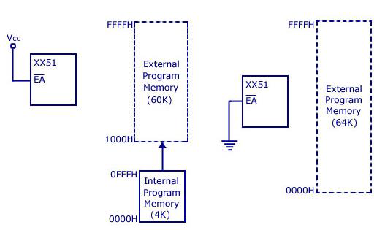
ROM /Program Memory

Slide 28
RAM/Data Memory
Internal RAM
8051 has 128 bytes of internal RAM having addresses from 00h to 7F h.
It is organized into 3 regions
1. Register banks-32 bytes- 00h to 1Fh
2. Bit addressable memory-16 bytes- 20h to 2Fh
3.General Purpose (scratch pad) RAM-80 bytes- 30h to 7Fh

Slide 29
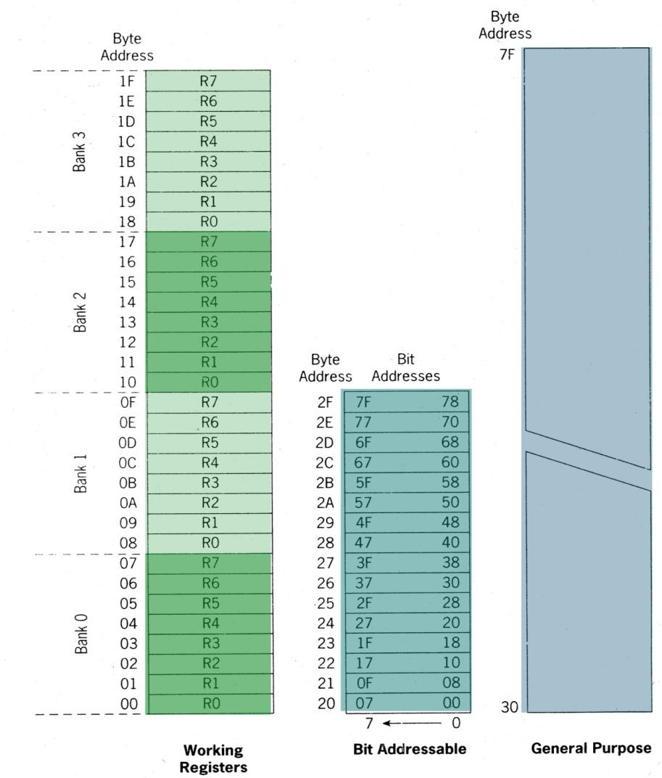

Slide 30
RAM/Data Memory
Register banks-32 bytes- 00h to 1Fh
Organized as 4 register banks
Each register bank contains 8 registers –R0 to R7
Registers may be addressed by name or by internal RAM address
RS0 and RS1 of PSW determine which bank is currently in use
Default bank is bank0

Slide 31
RAM/Data Memory
2.Bit addressable memory-16 bytes- 20h to 2Fh
128 bits
May be addressed by bit address or by byte address(as 8 bits)
Eg :Individual bits of the byte with byte address 20h can addressed using bit addresses 00h to 07h
3.General Purpose (scratch pad) RAM-80 bytes- 30h to 7Fh
Byte addressable

Slide 32
Special Function registers
SFR registers uses the address range of 80h through FFh.
21 Special function registers (SFR) in 8051 micro controller
It includes Register A, Register B, Program Status Word (PSW), PCON etc. Each SFR has an address (80h through FFh) and a name.
Example: the accumulator having the address 0E0h.
Note : All addresses from 80 to FF are not used for SFRs; attempting to use an address that is not defined yields unpredictable results

Slide 33
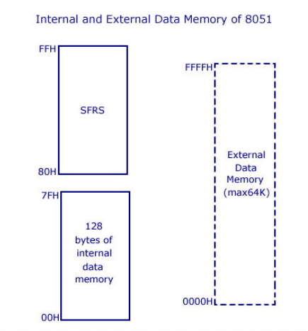
External RAM
External RAM up to 64 K can be added to 8051. It is accessed using DPTR.

Slide 34
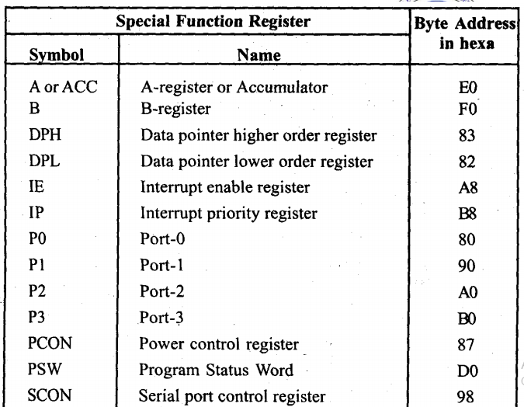
Registers

Slide 35
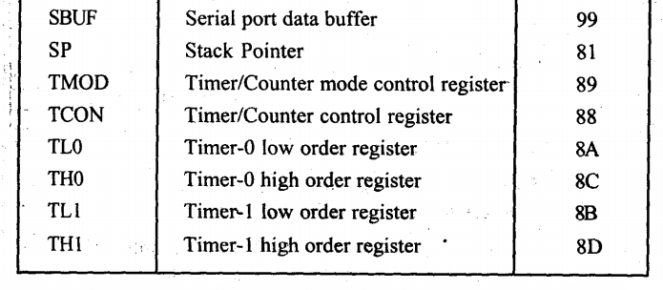
Registers

Slide 36
Register A/Accumulator
Accumulator which is also known as ACC or A is the most important of all special function registers.
It holds one of the operands and the result of most arithmetic and logic operations.
ACC can be accessed by direct addressing.
To access accumulator as a single byte (all 8 bits at once) the physical address E0H can be used.

Slide 37
Register A/Accumulator
Accumulator is both byte and bit addressable.
To access the first bit (i.e bit 0) use the physical address E0H or Acc.0 .
To access the second bit (i.e bit 1), E1H or Acc.1
For third bit E2H or Acc.2 and so on.

Slide 38
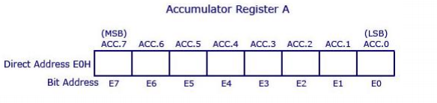
Register A/Accumulator

Slide 39
Register B
Register B holds the multiplier during multiplication and divisor during division.
Register B is also byte and bit addressable.
To access all 8 bits (as a single byte), physical address F0 is used.
To access bit 0, F0 or B.0 is used. To access bit 1 you may use F1or B.1 and so on.
Register B can also be used for other general purpose operations.

Slide 40
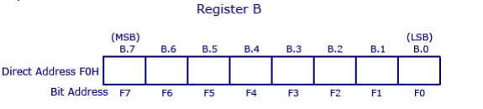
Register B

Slide 41
Port Registers
8051 has 4 I/O ports named P0, P1, P2 and P3.
Each port has got a corresponding port register with the same name.
Data must be written into port registers first to send it out to any other external device through ports.
Similarly any data received through ports must be read from port registers.
All 4 port registers are bit as well as byte addressable.

Slide 42
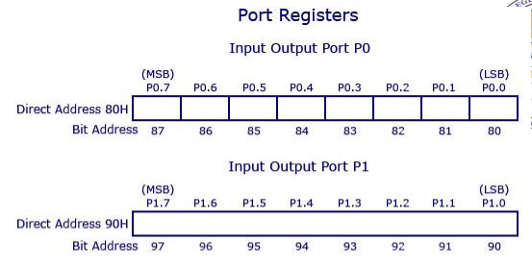
Port Registers

Slide 43
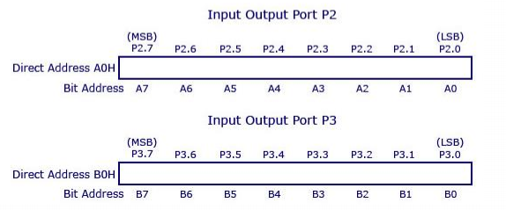
Port Registers
The physical addresses of the port registers are : P0-80h, P1-90h, P2-A0h and P3- B0h

Slide 44
Stack Pointer
Stack pointer is an 8 bit register which points to the last stored location of the stack.
Before storing a byte in stack, the SP is incremented by 1.
After a system reset SP is initialized to the default value 07H
Data can be stored to stack from 08H onwards.
The programmer can alter the value of SP if required.

Slide 45
Data Pointer
The Data Pointer (DPTR) is a user-accessible 16-bit register used by the 8051 to access external memory.
It can also be used to store 16 bit values.
It is a combination of two 8 bit registers DPH and DPL
which can be accessed independent

Slide 46
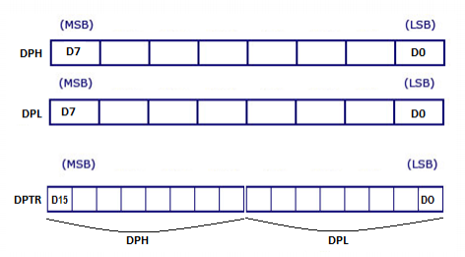
Data Pointer

Slide 47
Power Management Register (PCON)
Power management using a microcontroller is something you see every day in mobile phones.
Example : A mobile phone automatically going into stand by mode when not used for a couple of seconds or minutes
Commonly referred to as PCON register, this is a dedicated SFR for power management alone.

Slide 48
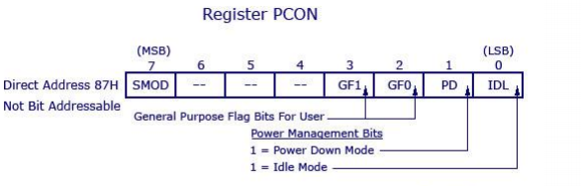
Power Management Register (PCON)
From the figure below you can observe that there are 2 modes for this register :- Idle mode and Power down mode

Slide 49
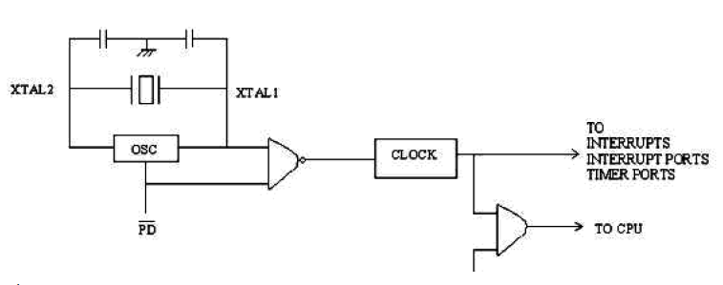

Slide 50
Idle Mode
Idle mode is entered by setting IDL bit to 1 .
The clock signal is gated off to CPU, but not to the interrupt, timer and serial port functions.
The CPU status is preserved entirely. SP, PC, PSW, Accumulator and other registers maintain their data during IDLE mode. The port pins hold their logical states they had at the time Idle was initiated. ALE and are held at logic high levels.

Slide 51
Idle Mode
Ways to exit Idle Mode:
Activation of any enabled interrupt will clear PCON.0 bit and hence the Idle Mode is exited.
The program goes to the Interrupt Service Routine (ISR). After RETI is executed at the end of the ISR, the next instruction will start from the one following the instruction that enabled Idle Mode.
A hardware reset exits the idle mode. The CPU starts from the instruction following the instruction that invoked the 'Idle' mode.

Slide 52
Power Down Mode
The Power down Mode is entered by setting the PD bit to 1.
The internal clock to the entire microcontroller is stopped (frozen). However, the program is not dead.
The Power down Mode is exited (PCON.1 is cleared to 0) by Hardware Reset only.
The CPU starts from the next instruction where the Power down Mode was invoked.
Port values are not changed/ overwritten in power down mode.
Vcc can be reduced to as low as 2V in Power down mode. However, Vcc has to be restored to normal value before Power down mode is exited.

Slide 53
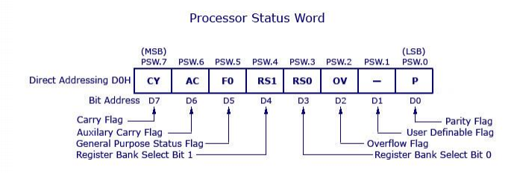
Processor Status Word (PSW)

Slide 54
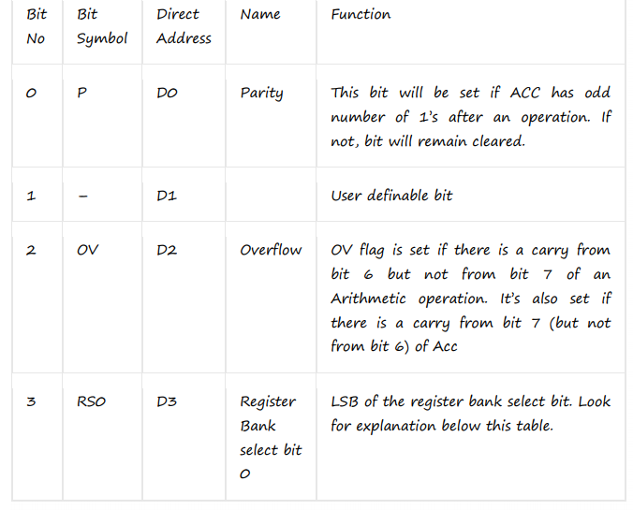
Processor Status Word (PSW)

Slide 55
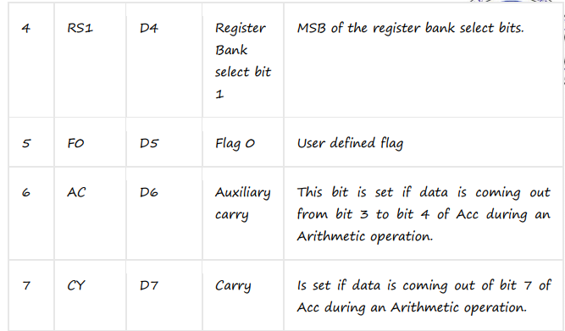
Processor Status Word (PSW)

Slide 56
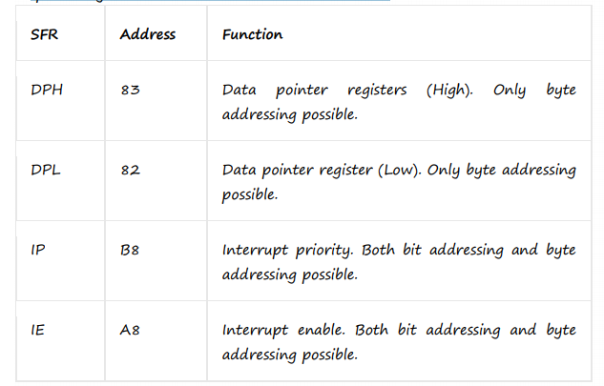
SFR
There are 21 SFR’s ,we have discussed only 9 specifically.
The table below lists all other 12 SFR’s

Slide 57
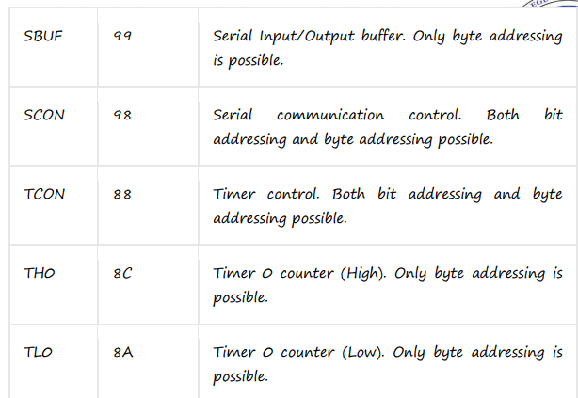
SFR

Slide 58
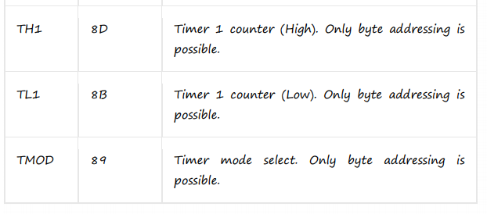
SFR

Slide 59
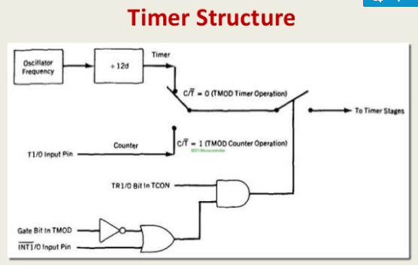

Slide 60
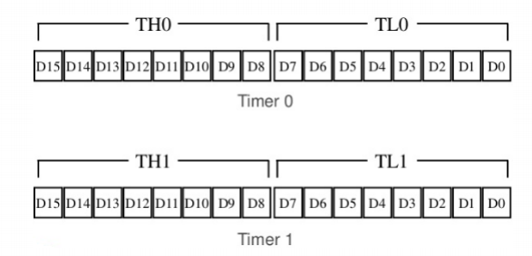
Timer Registers

Slide 61
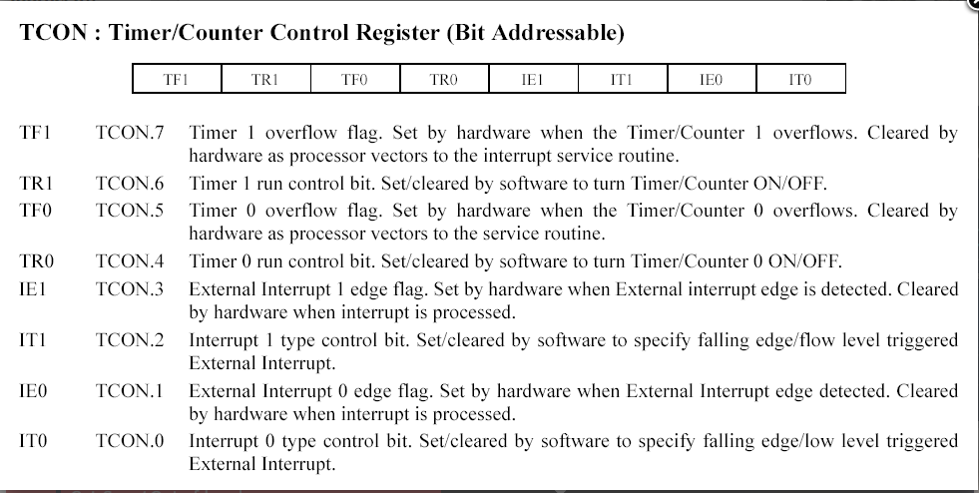

Slide 62
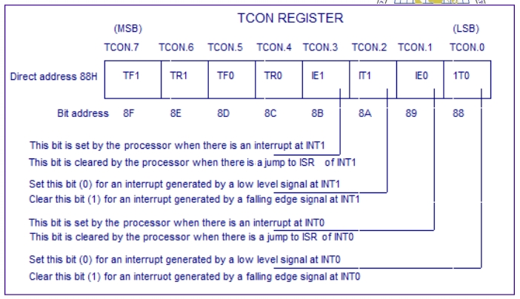
TCON Registers

Slide 63
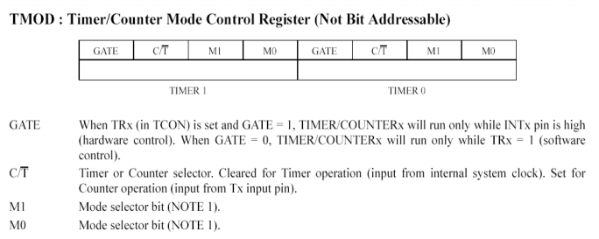

Slide 64
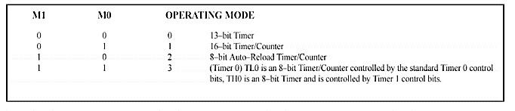

Slide 65
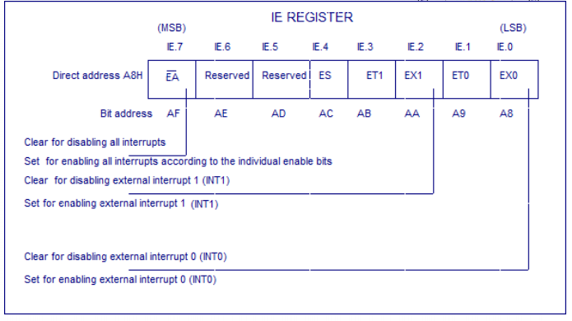
Interrupt Enable Register

Slide 66
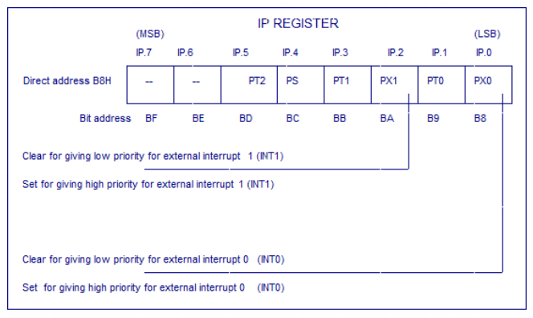
Interrupt Priority Register

Slide 67
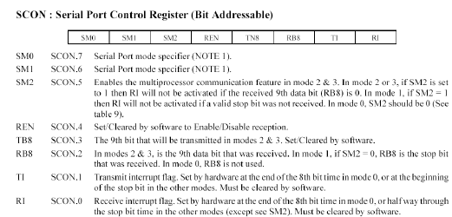
SCON Register

Slide 68
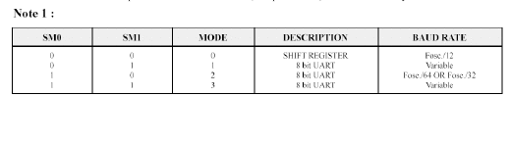

Slide 69
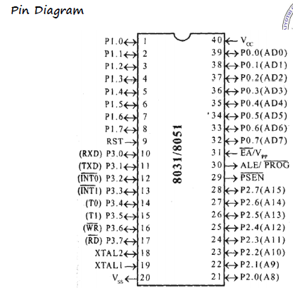
Pin Diagram

Slide 70
Pins 1-8: Port 1 :Each of these pins can be configured as an input or an output.
Pin 9: RST : a HIGH on this pin resets the microcontroller. The program starts execution from 0000h. All internal registers are reset to default values.
Pins10-17: Port 3 Similar to port 1, each of these pins can serve as general input or output. Besides, all of them have alternative functions:
Pin 10: RXD Serial communication input
Pin 11: TXD Serial communication output

Slide 71
Pin 12: INT0 External Interrupt 0 input.
Pin 13: INT1 External Interrupt 1 input.
Pin 14: T0 Timer 0 external clock input.
Pin 15: T1 Timer 1 external clock input.
Pin 16: WR External Data memory write control signal
Pin 17: RD External data memory read control signal.
Pin 18, 19: XTAL2 , XTAL1 . A quartz crystal which specifies operating frequency is usually connected to these pins.
Pin 20: VSS or GND Ground.

Slide 72
Pin 21-28: Port 2 If there is no intention to use external memory then these port pins are configured as general inputs/outputs. In case external memory is used, the higher address byte, i.e. addresses A8-A15 will appear on this port.
Pin 29: PSEN Program Store Enable: If external ROM is used for storing program then the microcontroller reads a byte from memory whenever a logic zero (0) appears on it. This pin is usually connected to the OE –output enable pin of external ROM.

Slide 73
Pin 30: ALE/PROG-Address Latch Enable : Prior to reading from external memory, the microcontroller puts the lower address byte (A0-A7) on P0 and activates the ALE output. After receiving signal from the ALE pin, the external register (usually 74HCT373 or 74HCT375 add-on chip) latches the state of P0 and uses it as a memory chip address. Immediately after that, the ALU pin is returned to its previous logic state and P0 is now used as a Data Bus.

Slide 74
Pin 31: EA/Vpp – External Access: If this pin is grounded the program written in external ROM will be executed. If the EA pin is connected to Vcc, the microcontroller will use both memories, first internal then external (if external exists).
Pin 32-39: Port 0 Similar to P2, if external memory is not used, these pins can be used as general inputs/outputs. Otherwise, P0 is configured as address output (A0-A7) when the ALE pin is driven high (1) or as data output (Data Bus) when the ALE pin is driven low (0).
Pin 40: VCC +5V power supply.

Slide 75
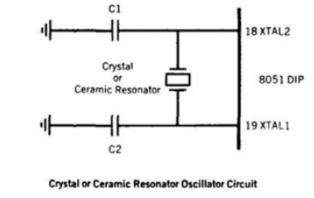
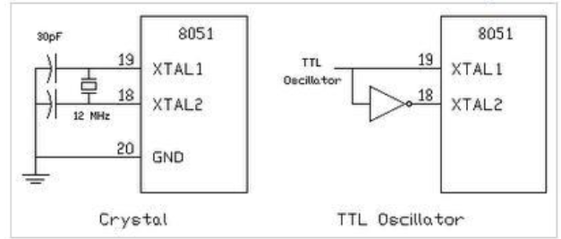
Oscillator and clock of 8051

Slide 76
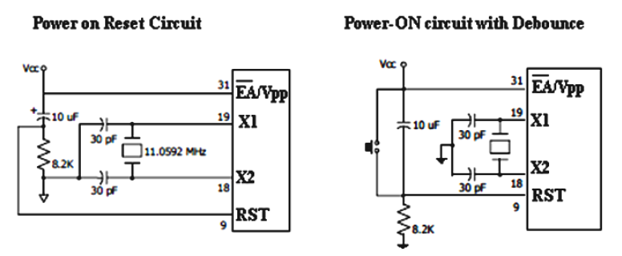
Reset

Slide 77
Reset
8051 can be reset in two ways 1) is power-on reset – which resets the 8051 when power is turned ON and 2) manual reset – in which a reset happens only when a push button is pressed manually.
Power-On Reset
Initially charging of capacitor makes RST High
When capacitor charges fully it blocks DC.

Slide 78
Manual reset
Closing the switch momentarily will make RST High.
A reset doesn’t affect contents of internal RAM. For reset to happen, the reset input pin (pin 9) must be active high for atleast 2 machine cycles. During a reset operation :- Program counter is cleared and it starts from 0000H, register bank0 is selected as default, Stack pointer is initialized to 07H, all ports are written with FFH.

Slide 79
I/O ports
Each port has a D-type output latch for each pin.
The SFR for each port is made up of these eight latches; which can be, addressed at the SFR address for that port.
For example, the eight latches for port 0, can be addressed at location 80h; these are also bit addressable.
The port latches should not be confused with the port pins
The data on the latches need not be the same as that on the pins.
Two data paths are shown in Figure; upper buffer is enabled when latch data is read, and lower buffer is enabled when pin is read.
Different opcodes access the latch or pin states as appropriate.

Slide 80
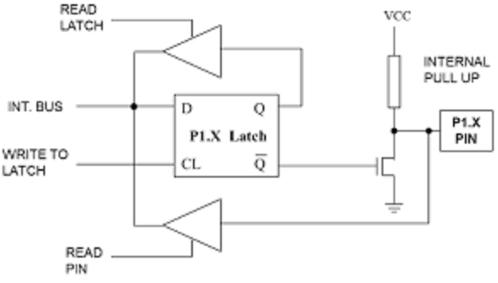
PORT1 Structure

Slide 81
Port 1 Structure
Port 1 pins have no dual functions.
Therefore, the output latch is connected directly to the gate of the lower FET.
This port has an FET circuit labeled Internal FET Pull-up as an active pull-up load.

Slide 82
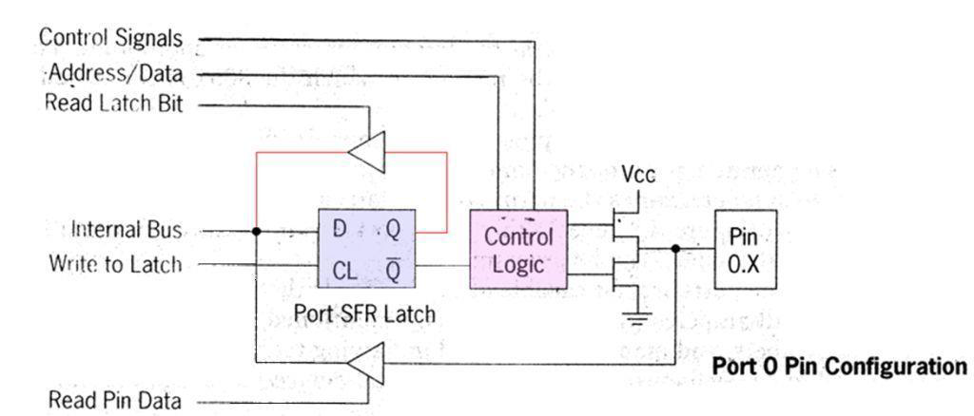
Port 0 Structure

Slide 83
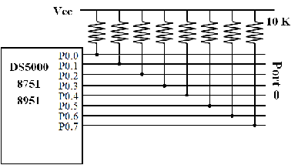
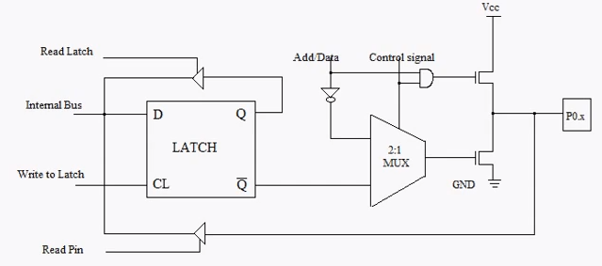
Port 0 Structure

Slide 84
Port 0 Structure
Port 0 pins may serve as inputs, outputs or, when used together, as a bi-directional low-order address and data bus (AD0-AD7)for external memory.
When a pin is to be used as an input, a 1 must be written to the corresponding port 0 latch by the program,
It turns both of the output transistors off, causes the pin to "float" in a high-impedance state. The pin is connected to the input buffer.

Slide 85
Port 0 Structure
When used as an output, the pin latches that are programmed to a 0 will turn on the lower FET grounding the pin.
All latches that are programmed to a 1 still float; thus, external pullup resistors will be needed to supply a logic high when using port 0 as an output.

Slide 86
Port 0 Structure
When port 0 is used as address bus to access external memory, internal control signals switch the address lines to the gates of the Field effect Transistors(FETs).
A logic 1 on an address bit will turn the upper FET on and the lower FET off to provide a logic high at the pin.
When the address bit is a zero, the lower FET is on and the upper FET off to provide a logic ‘0’ at the pin.

Slide 87
Port 0 Structure
After the address has been formed and latched into external circuits by the Address Latch Enable (ALE) pulse, the bus is turned around to become a data bus.
Port 0 now reads data from the external memory and must be configured as input, so logic 1 is automatically written by internal control logic to all port 0 latches.

Slide 88
Port 2 Structure
Port 2 may be used as an input/output port similar in operation to port 1.The alternate use of port2 is to supply high-order address byte to address external memory.
Port2 latches remain stable when external memory is addressed, as they do not have to be turned around for data input as is the case for port 0.

Slide 89
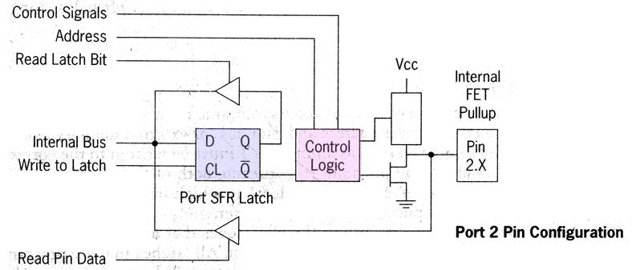

Slide 90
Port 3 Structure
Port 3 is an input/output port similar to port 1. The input and output functions can be programmed under the control of the p3 latches or under the control of various other special function registers.

Slide 91
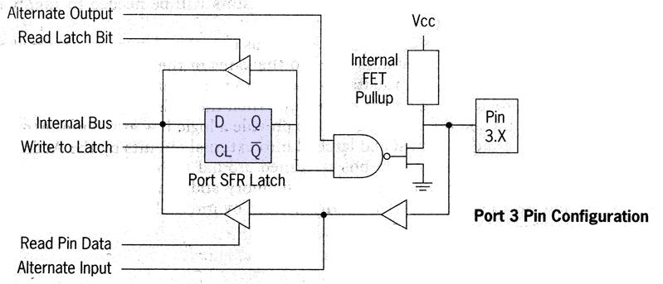
Port 3 Structure

Slide 92
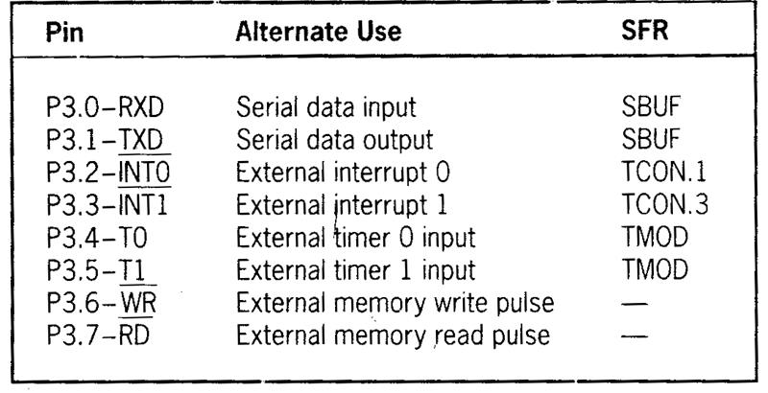
Port 3 Structure
The port 3 alternate uses are shown in the following table:

Slide 93
P1-P3 operation
When used as an input, a 1 is written to the latch, turning the lower FET off; the pin and the input to the pin buffer are pulled high by the FET load. An external circuit can overcome the high-impedance pullup and drive the pin low to input a 0 or leave the input high for a 1.
Reading the i/p pin
1. ‘1’ is written to the port latch. The D latch has 1 on its Q o/p and 0 on its Q output
2. Lower transistor M1 is turned OFF
3. i/p pin is connected to tristate buffer (TB1)( and is pulled high by internal FET pull up)
4. Instruction ( eg MOV A,P1) reads data present at the pin ( if i/p is ‘0’ external circuits ground the pin, if not the pin remains at logic ‘1’)

Slide 94
P1-P3 operation
If used as an output, the latches containing a 1 can drive the pin high through the pullup. If a 0 is written to the latch, the lower FET is on, the pullup is off, and the pin is driven low.
Writing ‘1’ to the o/p pin
1. ‘1’ is written to the port.
2. Lower transistor M1 is turned OFF
3. pin is pulled high by internal FET pull up

Slide 95
P1-P3 operation
Writing ‘0’ to the o/p pin
1. ‘0’ is written to the port.
2. Lower transistor M1 is turned ON
3. pin is connected to the ground
While executing read modify write instructions port latch is read ( not pin)
Reading latch
1. Upper buffer (TB2) is enabled
2. Operation specified by the instruction is performed
3. Result is written to the latch

Slide 96
MICROCONTROLLER INSTRUCTION SET

Slide 97
INTRODUCTION
An instruction is an order or command given to a processor by a computer program. All commands are known as instruction set and set of instructions is known as program.
8051 have in total 111 instructions, i.e. 111 different words available for program writing.

Slide 98
Types Of Instructions
One/single byte instructions :
If operand is not given in the instruction or there is no digits present with instruction, the instructions can be completely represented in one byte opcode.
OPCODE 8 bit

Slide 99
Types Of Instructions
Two/double byte instruction:
If 8 bit number is given as operand in the instruction, the such instructions can be completed represented in two bytes.
First byte OPCODE
Second byte 8 bit data or I/O port

Slide 100
Types Of Instructions
Three/triple byte instruction:
If 16 bit number is given as operand in the instructions than such instructions can be completely represented in three bytes 16 bit number specified may be data or address.

Slide 101
Types Of Instructions
1. First byte will be instruction code.
2. Second byte will be 8 LSB’s of 16 bit number.
3. Third byte will be 8 MSB’s of 16 bit number.
First byte OPCODE.
Second byte 8 LSB’s of data/address.
Third byte 8 MSB’S of data/address.

Slide 102
Description of all 8051 instructions
Here is a list of the operands and their meanings:
A - accumulator Rn - is one of working registers (R0-R7) in the currently active RAM memory bank
Direct - is any 8-bit address register of RAM. It can be any general-purpose register or a SFR (I/O port, control register etc.)
@Ri - is indirect internal or external RAM location addressed by register R0 or R1
#data - is an 8-bit constant included in instruction (0-255)
#data16 - is a 16-bit constant included as bytes 2 and 3 in instruction (0- 65535)
addr16 - is a 16-bit address. May be anywhere within 64KB of program memory.
C - is carry flag of the status register (register PSW).

Slide 103
INSTRUCTION SET
Classified as follows:
Data transfer instructions
Arithmetic instructions
Logical instructions
Branch instructions
Subroutine instructions
Bit manipulation instructions

Slide 104
1.Data transfer instructions
In this group instructions perform data transfer operations
Syntax: Mov Destination,Source
Examples: If Rn =R3
MOV A,Rn // move contents of a register to Acc R3=05, A=05
MOV Rn,A // move contents of Acc to register A=05, R3=05
MOV A,#45H // move data 45 to Acc A=45
MOV Rn,# 0AH // move data 0A to a register R3=0A
MOV A,65H // move data at RAM location 65 to Acc
65
A=03
03

Slide 105

1.Data transfer instructions
MOV A,@Ri // move data at RAM location addressed by a register to Acc
(R0 & R1 can only be used)
If R1=65H
@ means “content of”
MOV Rn,65H // move data at RAM location 65 to Register ; R3=03
MOV 45H,Rn // move data at Register to RAM location 45; R3=06,
MOV 47H,65H // move data at RAM location 65 to RAM location 47
45
06
47
03

Slide 106

MOV 45H,@Ri // move data at RAM location addressed by a register to RAM location 45 (R0 & R1 can only be used)
If R1=65H ; Ans
MOVX A,@Ri // Copy the contents of external address in Ri to Acc.This copies the data from the 8 bit address in Ri to Acc
(R0 & R1 can only be used)
X stands for external Memory
65
06
45
06

Slide 107
MOVX A,@Dptr // Copies data from the 16 bit address in DPTR to Acc
If Dptr =2500H;
MOVX @Dptr,A // Copies data from Acc to 16 bit address in DPTR
If A=06;
2500
03
A=03
2500
06

Slide 108
Instructions to Access External ROM/Program Memory
MOVC A, @A + DPTR This copy the contents of the external ROM address formed by adding A and the DPTR, to A.
If DPTR =2500H ; A=06 ; A+DPTR =2506
MOVC A, @A + PC This copy the contents of the external ROM address formed by adding A and the PC, to A.
If PC =2500H ; A=06 ; A+PC =2506
Note: MOVC :- Move Code Memory
2506
03
A=03
2506
03
A=03

Slide 109
Instructions to Store /Retrieve data To/From Stack Memory
PUSH 6 // Increment SP (SP=SP+1) then, data at RAM location 06 is moved to stack memory addressed by SP
If SP=07H
SP : 08=04
POP 7 // Data at stack memory addressed by SP is moved to RAM location 07 the decrement SP (SP=SP-1)
SP=07
XCH A, Rn // Exchange the data at ACC and register Rn A=04; R3=03
06
04
07
04

Slide 110
2.Arithmetic instructions
Addition:
ADD A,#45H // A = A + 45
ADDC A,#0B4H // A = A + 0B4 + Carry Flag content
ADD A,Rn // A = A + Data at Rn
ADDC A,Rn // A = A + Data at Rn + Carry Flag content
ADD A,51H //A = A + Data at RAM location 51
ADDC A,51H // A = A + Data at RAM location 51 + CY Flag

Slide 111
Subtraction:
SUBB A,#45H // A = A - 45 - CY Flag
SUBB A,Rn // A = A - Data at Rn - CY Flag
SUBB A,51H // A = A - Data at RAM location 51 - CY Flag

Slide 112
Multiplication:
MUL AB= A*B
Multiplies two 8 bit numbers stored in Accumulator and register B
Lower byte of the result will be stored in accumulator and higher byte of the result will be stored in register B
Division:
DIV AB=A/B
Divides two 8 bit numbers stored in Accumulator and register B
result will be stored in accumulator and remainder will be stored in register B

Slide 113
Increments:
INC A // A=A+1
INC Rn // Rn=Rn+1
Increments the value of source by 1
If initial value if FFh on incrementing the value will reset to Zero
Decrements:
DEC A // A = A - 1
DEC Rn // Rn = Rn – 1
Decrements the value of source by 1
If initial value if zero on decrementing the value will reset to FFh

Slide 114
3.Logical instructions
Logical AND:
ANL A,#Data // A = A and Immediate data
ANL A,Rn // A= A and Data at Rn
Logical OR:
ORL A,#Data // A = A or Immediate data
ORL A,Rn // A= A or Data at Rn
Logical EX-OR:
XRL A,#Data // A = A Ex or Immediate data
XRL A,Rn // A= A Ex or Data at Rn
Logical NOT:
CPL A // Invert all bits in Acc
CPL C // Invert Carry Flag
CPL bit address (Eg :CPL 07) // 07 is the address of 8th bit of first bit addressable memory location. Invert it
Swapping of Accumulator Data:
SWAP A // Swap the upper nibble & lower nibble of A

Slide 115


Rotate Instructions:
1.RR A
Rotate right the accumulator
Each bit is shifted one location to the right, with bit 0 going to bit 7.
2.RL A
Rotate left the accumulator
Each bit is shifted one location to the left, with bit 7 going to bit 0

Slide 116


3.RRC A
Rotate right through the carry
Each bit is shifted one location to the right, with bit 0 going into the carry bit in the PSW, while the carry was at goes into bit 7
4.RLC A
Rotate left through the carry.
Each bit is shifted one location to the left, with bit 7 going into the carry bit in the PSW, while the carry goes into bit 0.

Slide 117
4.Branch instructions
Two Types:
Unconditional jump instruction
Upon their execution a jump to a new location from where the program continues execution is executed.
b) Conditional jump instruction
A jump to a new program location is executed only if a specified condition is met. Otherwise the program normally proceeds with the next instruction.

Slide 118
The unconditional jump is a jump in which control is transferred unconditionally to the target location
LJMP (long jump)
3-byte instruction
First byte is the opcode
Second and third bytes represent the 16-bit target address
Any memory location from 0000 to FFFFH
SJMP (short jump)
2-byte instruction
First byte is the opcode
Second byte is the relative target address
00 to FFH (forward +127 and backward
-128 bytes from the current PC)

Slide 119
To calculate the target address of a short jump (SJMP, JNC, JZ, DJNZ, etc.)
The second byte is added to the PC of the instruction immediately below the jump
If the target address is more than -128 to +127 bytes from the address below the short jump instruction
The assembler will generate an error stating the jump is out of range

Slide 120


Slide 121


Slide 122
5.Subroutine instructions
Call instruction is used to call subroutine
Subroutines are often used to perform tasks that need to be performed frequently
LCALL (long call)
3-byte instruction
First byte is the opcode
Second and third bytes are used for address of target subroutine
– Subroutine is located anywhere within 64K byte address space
ACALL (absolute call)
2-byte instruction
11 bits are used for address within 2K-byte range

Slide 123
When a subroutine is called, control is transferred to that subroutine, the processor
Saves on the stack the the address of the instruction immediately below the LCALL
Begins to fetch instructions form the new location
After finishing execution of the subroutine
The instruction RET transfers control back to the caller
Every subroutine needs RET as the last instruction

Slide 124


Slide 125
The only difference between ACALL
and LCALL is
The target address for LCALL can be anywhere within the 64K byte address
The target address of ACALL must be within a 2K-byte range
The use of ACALL instead of LCALL can save a number of bytes of program ROM space

Slide 126
Addressing Modes
ADDRESSING MODES
The method of specifying the data to be operated by the instruction is called addressing
8051 addressing modes are classified as follows.
Immediate addressing.
Register addressing.
Direct addressing.
Indirect addressing.
Indexed addressing

Slide 127
Addressing Modes
Immediate addressing.
In this addressing mode the data is provided as a part of instruction itself.
In other words data immediately follows the instruction.
Eg. MOV A,#30H It means that immediate data 30h provided in instruction is moved into A register.
ADD A, #83 It means that immediate data 30h provided in instruction is added with A register.
# Symbol indicates the data is immediate.

Slide 128
Addressing Modes
Register addressing.
In this addressing mode the register will hold the data.
One of the eight general registers (R0 to R7) can be used and specified as the operand.
Eg. MOV A,R0 Content of R0 register is copied into Accumulator.
ADD A,R6 Content of R0 register is added with Accumulator.
R0 – R7 will be selected from the current selection of register bank. The default register bank will be bank 0.

Slide 129
Addressing Modes
Direct addressing
In this mode the direct address of memory location is provided in instruction to fetch the operand.
Only internal RAM and SFR's address can be used in this type of instruction.
Ex: MOV A, 30H => Content of RAM address 30H is copied into Accumulator.

Slide 130
Addressing Modes
Indirect addressing
Here the address of memory location is indirectly provided by a register.
The '@' sign indicates that the register holds the address of memory location i.e. fetch the content of memory location whose address is stored in register.
Ex: MOV A,@R0 => Copy the content of memory location whose address is given in R0 register.

Slide 131
Addressing Modes
Indexed addressing
This addressing mode is basically used for accessing data from look up table.
Here the address of memory is indexed i.e. added to form the actual address of memory.
Ex: MOVC A, @A+DPTR => here 'C' means Code. Here the content of A register is added with content of DPTR and the resultant is the address of memory location from where the data is copied to A register.

